Slide 1


SCS1306-DBMS
SATHYABAMA
INSTITUTE OF SCIENCE AND TECHNOLOGY
DATA BASE SECURITY
Dr.L.LAKSHMANAN
DEPARTMENT OF COMPUTER SCIENCE AND ENGINEERING

Slide 2
What is Database Security ?
DataBase:
It is a collection of data ,generally stored and accessed
electronically from a computer system.
Security
It is being free from danger.
Database Security
It is the mechanisms that protect the database against
intentional or accidental threats.

Slide 3
Major Security Vulnerabilities
Bugs in database software components(eg-buffer overflow)
Improper security configurations
Use of default user accounts and passwords
Use of null passwords
Excessive privileges
Lack of network isolation(external or internal)

Slide 4
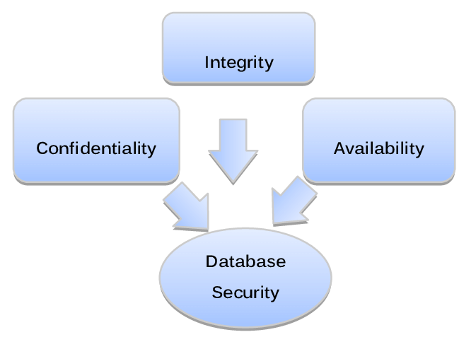

Slide 5
Database Security Issues
Types of Security
Legal and ethical issues
Policy issues
System-related issues
The need to identify multiple security levels

Slide 6
Database Security Issues
A DBMS typically includes a database security and authorization subsystem that is responsible for ensuring the security portions of a database against unauthorized access.
Two types of database security mechanisms:
Discretionary security mechanisms
Mandatory security mechanisms

Slide 7
Database Security Issues
The security mechanism of a DBMS must include provisions for restricting access to the database as a whole; this function is called access control and is handled by creating user accounts and passwords to control login process by the DBMS.
The security problem associated with databases is that of controlling the access to a statistical database, which is used to provide statistical information or summaries of values based on various criteria.
The countermeasures to statistical database security problem is called inference control measures.

Slide 8
Database Security Issues
Another security is that of flow control, which prevents information from flowing in such a way that it reaches unauthorized users.
Channels that are pathways for information to flow implicitly in ways that violate the security policy of an organization are called covert channels.
A final security issue is data encryption, which is used to protect sensitive data (such as credit card numbers) that is being transmitted via some type communication network.

Slide 9
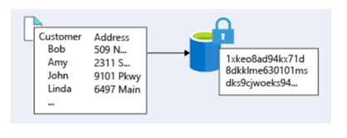
Database Security Issues
The data is encoded using some coding algorithm. An unauthorized user who access encoded data will have difficulty deciphering it, but authorized users are given decoding or decrypting algorithms (or keys) to decipher data.

Slide 10
Database Security and the DBA
The database administrator (DBA)
The DBA has a DBA account in the DBMS, sometimes called a System or Super user account, which provides powerful capabilities

Slide 11
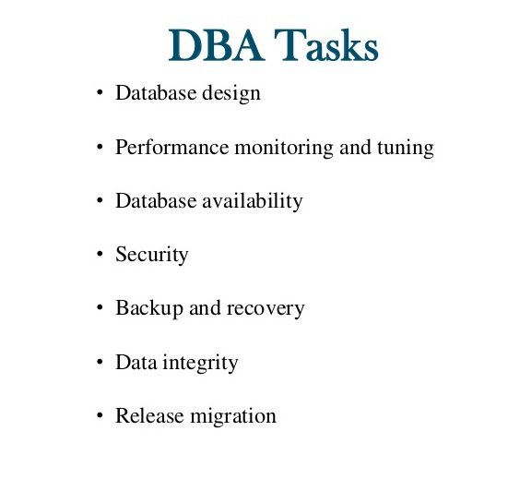
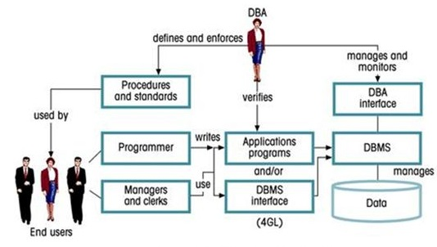

Slide 12
Database Security and the DBA
1. Account creation
2. Privilege granting
3. Privilege revocation
4. Security level assignment
Action 1 is access control,
2 and 3 are discretionary and
4 is used to control mandatory authorization.

Slide 13
Access Protection, User Accounts, and Database Audits
Whenever a person or group of persons need to access a database system, the individual or group must first apply for a user account.
The DBA will then create a new account number and password for the user if there is a legitimate need to access the database.
The user must log in to the DBMS by entering account number and password whenever database access is needed.

Slide 14
Types of Discretionary Privileges
The account level: At this level, the DBA specifies the particular privileges that each account holds independently of the relations in the database.
The relation (or table level): At this level, the DBA can control the privilege to access each individual relation or view in the database.
The privileges at the account level
CREATE SCHEMA or CREATE TABLE
CREATE VIEW privilege;
ALTER privilege,
DROP privilege,
SELECT privilege

Slide 15
Key Difference
grant vs revoke
grant is a DCL command that allows providing privileges for the users on the database objects. | revoke is a DCL command that allows taking back the permission assigned to a user.
In Decentralized Control
The grant is easier. | The revoke is complex.
Usage
Allows assigning access rights to the users. | Allows removing the access rights from the users.

Slide 16
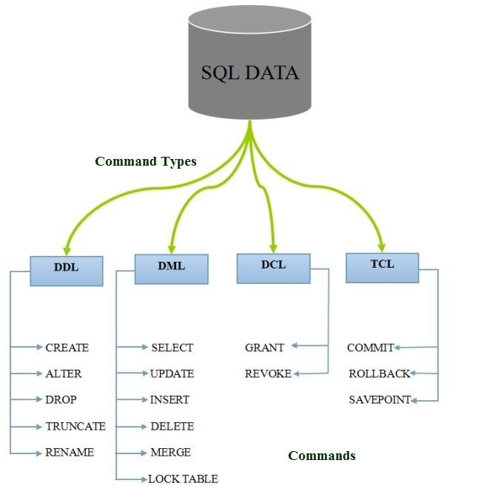

Slide 17
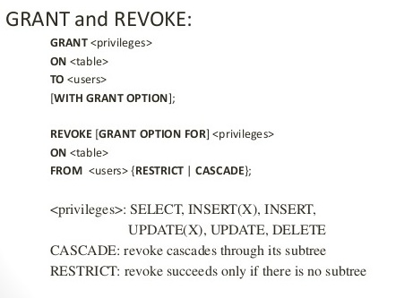
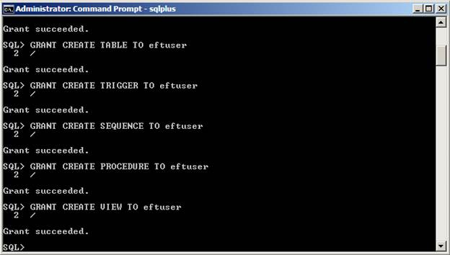

Slide 18
Mandatory Access Control
In many applications, and additional security policy is needed that classifies data and users based on security classes.
Mandatory policies ensure a high degree of protection in a way, they prevent any illegal flow of information

Slide 19
Typical security classes
Top secret (TS),
Secret (S),
Confidential (C),
unclassified (U),
TS is the highest level and U the lowest
The commonly used model for multilevel security, known as the Bell-LaPadula model.

Slide 20
Security Classifications
subject (user, account, program)
object (relation, tuple, column, view, operation)
Two restrictions are enforced on data access based on the subject/object classifications:
simple security property-A subject S is not allowed read access to an object O unless class(S) ≥ class(O).
star property -A subject S is not allowed to write an object O unless class(S) ≤ class(O).

Slide 21
Role-Based Access Control
RBAC-managing and enforcing security in large-scale enterprise wide systems
Roles can be created using the CREATE ROLE and DESTROY ROLE
CREATE ROLE role_name [WITH ADMIN {CURRENT_USER
| CURRENT_ROLE}]
Role hierarchy in RBAC is a natural way of organizing roles to reflect the organization’s lines of authority and responsibility.
Many DBMSs have allowed the concept of roles, where privileges can be assigned to roles.

Slide 22
THANK YOU
ANY QUERIES ?
Dr.L.LAKSHAMAN
Lakshmanan.cse@sathyabama.ac.in

